Slide 1
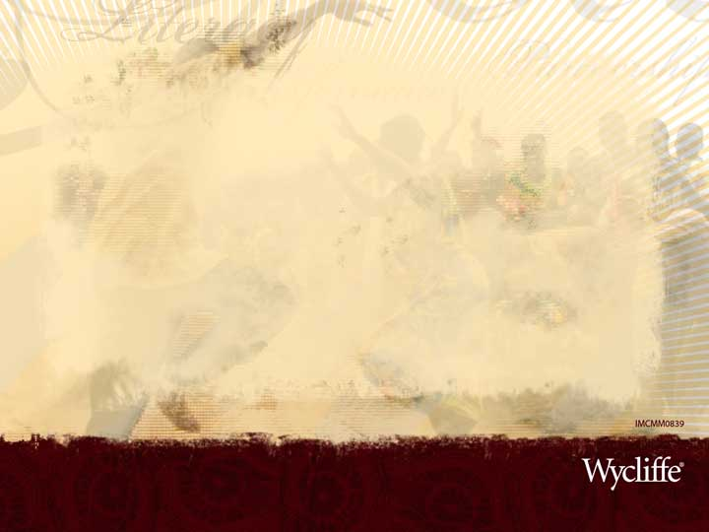
God as Creator
Where does language fit in?
Notes:
Language – expressing ourselves audibly – is an integral part of our lives. We do not live our lives without some form of language.
In many ways, you could say that language is part of our nature – that we are compelled to communicate and express ourselves.
Apart from the use of language in Scripture itself, language appears as a “character” in the Bible in a few ways.
I want to highlight for you some of the interconnected moments in God’s history with creation and with humans where language takes a prominent role.
My hope is that you will grasp a few aspects of “the big picture” that will enrich your worship and enjoyment of God and Scripture.
Caveats!
I’m not a theologian, so I will grant from the start that I may be missing pieces of the equation that would change my points here.
I’m not trained in Biblical languages, so I’ll also grant that there may be nuances of those languages that would also change my ideas.
I don’t want this to be a “heady” thing – I want you to “get it”, so I’m happy to answer your questions or discuss your thoughts.

Slide 2
Words and Names
“Then God said, “Let there be ….”
“The Lord merely spoke, and the heavens were created. He breathed the word, and all the stars were born.”
God calls all things into being with speech – or even just breath.
“He brought them to the man to see what he would call them, and the man chose a name for each one.”
Humans can only describe what God has made.
Notes:
God alone is able to create through speaking.
Humans are able to use language to identify or describe that which has already been made.
We cannot speak and bring something into being. Even the most thoughtful and eloquent expression of an idea, evoking powerful imagery in the mind of the listener, cannot cause that idea to suddenly “be”.
We humans can make, but we cannot make something from nothing.
Bringing the animals to Adam was part of the process of finding a “helper” from him. God was looking for some indication in the name of a thing that what He created was a good match for the man.
The man recognized that the woman was like him, and had come from him, and he named her accordingly.
References:
Genesis 1:3-25
Psalm 33:6
Genesis 2:19

Slide 3
More than a Word
“In the beginning the Word already existed. The Word was with God, and the Word was God.”
“The Word gave life to everything that was created ….”
“He is the Word of life.”
“… his title was the Word of God.”
At creation, and eternally, God’s own presence – His Person – is His Word.
Jesus is the ultimate Word and Personal expression of God.
Notes:
Notes:
John gives us a glimpse here of Jesus long before He was ever known by that name and in that form.
We also learn that, for God at least, there is much more to speaking than the communication of thoughts, ideas, and commands. It’s Him with shape and form in our world. The Word of God is truly Immanuel, “God with us”.
Note that God did not speak humans into being. We were “formed” from the stuff of the earth and had life breathed into us. (Genesis 2:7)
The first woman was created from the stuff of the first man – neither was made from nothing.
I’m hypothesizing here that God’s “word-ing” a human is reserved for Jesus, who “is the visible image of the invisible God” and “lives all the fullness of God in a human body.” (Colossians 1:15, 2:9)
The was a time, and a place, and a purpose for this “Word-ing” to occur.
If humans wish to “make” a person, we again have our options limited (as with other “making”) – our children are not an automatic, always-part-of-us expression of our character, thoughts, and will. Even if we could clone ourselves, the clone would not be a perfect representation of us – each would have a will of his or her own.
God certainly does not have the same limitations – Word-ing is enough.
References:
John 1:1
John 1:4
1 John 1:1
Revelation 19:13

Slide 4
More than a Name
“I am El-Shaddai—‘God Almighty.’”
“‘Why do you want to know my name?’ the man replied.”
“I Am Who I Am.”
“This is my eternal name, my name to remember for all generations.”
“… I did not reveal my name, Yahweh, to them.”
“‘Why do you ask my name?’ the angel of the Lord replied. ‘It is too wonderful for you to understand.’”
“… you are to name him Jesus …”
“A name was written on him that no one understood except himself.”
Notes:
Notes:
While humans may refer to God with various names, God chooses – and reveals – His own Name for Himself.
Later, God makes an important statement to King David about His name: “He is the one who will build a house—a temple—for my name.” But this statement goes well beyond a promise about David’s successor, King Solomon: “… I will secure his royal throne forever. I will be his father, and he will be my son.” (2 Samuel 7:13-14)
God’s Presence and His Name lived in the tabernacle and the temple.
Even later, Jesus said, “Destroy this temple, and in three days I will raise it up.” (John 2:20)
“But when Jesus said ‘this temple,’ he meant his own body.” (John 2:21)
Like before, I’m hypothesizing that God reserved the name-ing for Himself – for His very Self. Any earlier instance served as a promise of what was to come: “Therefore, God elevated him to the place of highest honor and gave him the name above all other names, that at the name of Jesus every knee should bow, in heaven and on earth and under the earth, and every tongue confess that Jesus Christ is Lord, to the glory of God the Father.” (Philippians 2:9-11)
References:
Genesis 17:1
Genesis 32:29
Genesis 3:14
Exodus 3:15
Exodus 6:3
Judges 13:18
Matthew 1:21
Revelation 19:12

Slide 5
Fast Forward …
After the flood, God told the survivors to “… be fruitful and multiply, and repopulate the earth.”
Noah’s sons and daughters-in law did have many children.
An interesting mention is made about the name and life of Shem’s great-great-grandson, Peleg.
Peleg was born 131 years after the flood.
“… during his lifetime the people of the world were divided into different language groups.”
Notes:
Notes:
A specific person is identified and associated with the appearance of multiple languages and the division of the people. The account we are about to read and discuss is no “fairy tale”, but an event that had witnesses who passed their testimony on to subsequent generations.
References:
Genesis 9:7
Genesis 10:25

Slide 6
What happened?
“At one time all the people of the world spoke the same language and used the same words.”
A language is more likely to stay the same when its speakers all live in the same general area.
“As the people migrated to the east, they found a plain in the land of Babylonia and settled there.”
Within 340 years of the flood, people pointedly ignore God’s command to “fill the earth”.
Notes:
Notes:
We do not know what this “proto-language” was like. There is insufficient evidence in modern languages to reconstruct it or even to suggest that it is possible to derive it from what we observe and speak today. Many people have tried!
Peleg was born 131 A.F. and lived for 209 years.
References:
Genesis 11:1
Genesis 11:2

Slide 7
How did God respond?
“‘ Look!’ he said. ‘The people are united, and they all speak the same language. After this, nothing they set out to do will be impossible for them! Come, let’s go down and confuse the people with different languages. Then they won’t be able to understand each other.’”
The 6,909 languages we see in the world today is the direct result of our ancestors disobeying God.
Notes:
Notes:
And on top of this, the people said of the planned city, “This will make us famous and keep us from being scattered all over the world.”
See www.ethnologue.com for more information about the languages of today.
References:
Genesis 11:6-7

Slide 8
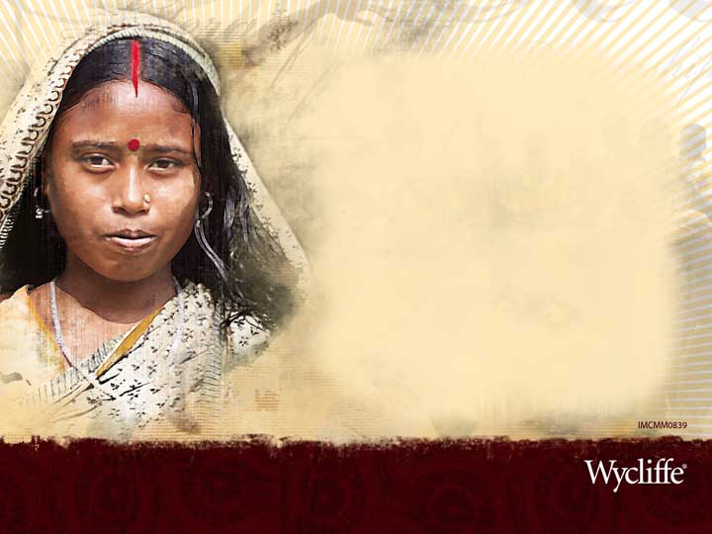
What was the result?
“In that way, the Lord scattered them all over the world, and they stopped building the city. That is why the city was called Babel, because that is where the Lord confused the people with different languages.”
When people are separated from contact, their language tends to change over time.
God kick-started this process by immediately creating perhaps 52+ languages on the spot.
Notes:
Notes:
Example: In Papua New Guinea, a mountainous island country, small groups of people are separated by imposing hills and mountains. As a result, they speak 830 languages, 12% of the global total, with ~4,600 people in each group (on average; 1,200 is the median).
Example: English has its origins in the Germanic language family. Related languages include modern German, Dutch, and Yiddish. As the Germanic peoples migrated westward, their languages changed due to lack of persistent contact with their relatives and from new contact with other peoples. A classic remnant of this relationship, apart from vocabulary, is “preposition stranding”, e.g. “What are you standing on?”
There are ~52 distinct groups mentioned in Genesis 10. It is easy to believe that, over the course of a few thousand years, these dozens of languages could develop into thousands.
References:
Genesis 11:8-9

Slide 9
How does this affect us today?
“… the Good News must first be preached to all nations.”
“… go and make disciples of all the nations …”
What you read as “nations” is translated from the same word that gives us “ethnic”.
This word conveys the sense of distinct groups of people who have their own language and culture.
We have to find them all!
Notes:
Notes:
Jesus appeared to one people, speaking just a few languages – and making good use of them all.
He certainly could have journeyed to all the peoples in the world – but He didn’t.
He specifically instructed His disciples to give the message to all peoples and languages around the globe.
At the time of the incident at Babel, He could have eased the spread the message of redemption by allowing the people to maintain their unity and their use of a single language – but He didn’t.
God had this work, which He assigned to us, in mind from the very beginning.
References:
Mark 13:10
Matthew 28:19

Slide 10
How does it all end?
“At that time there were devout Jews from every nation living in Jerusalem. When they heard the loud noise, everyone came running, and they were bewildered to hear their own languages being spoken by the believers.”
“After this I saw a vast crowd, too great to count, from every nation and tribe and people and language, standing in front of the throne and before the Lamb.”
We were separated by disobedience, but reconciled by the Lamb – the Word!
Notes:
Notes:
We have evidence of only one instance in which the new apostles demonstrate an ability to speak other languages without any effort of their own – God filled them with His Spirit.
At the same time God authenticated the apostles’ authority and message, He also confirmed the scope of their mission – to take this message to all people and languages.
It is not in a language, or in a place, or any other aspect of human life and relationship that we will be reconciled to each other.
We will only be reconciled to each other through being reconciled to God through Jesus Christ, the Word of God.
In the end, human language takes a back seat to the more important matter of the glory of God. The division has been overcome, and we can get on with bigger and better things!
As we ponder the cross and the empty tomb, as we devote ourselves to Jesus our redeemer – and at the same time consider all that is going on around us in this world – we must remember that the power to bring any amount of redemption, reconciliation, and renewal to this world comes only through God, who prepared all of this from the beginning in His acts of creation.
References:
Acts 2:5-6
Revelation 7:9

Slide 11
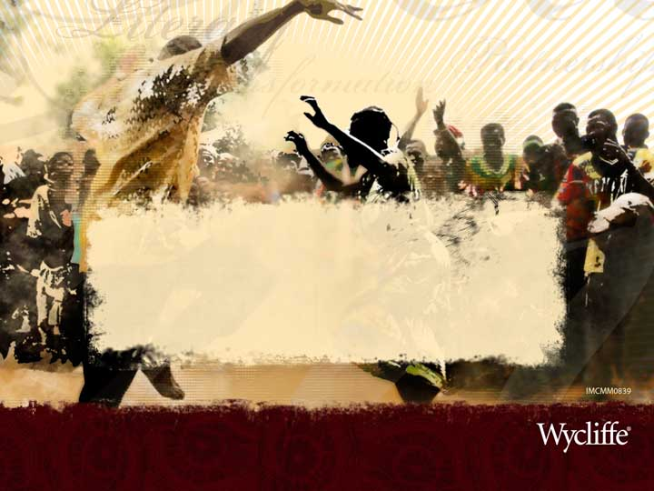
David and Katherine Liddle
www.liddles.net
Serving with Wycliffe to reach the last languages with the gospel

